Slide 1
My Time at the Woodrow Wilson House
Gabe Cronin-Golomb
Notes:
Hello everyone! My name is Gabriel Cronin-Golomb and I am one of the Fall 2021 Woodrow Wilson House Scholars. I have greatly enjoyed my time here, and I believe my project reflects my growth and development as an academic. I hope that my video will adequately demonstrate my project development, as I believe that it perfectly displays my growth and evolution during this program.

Slide 2
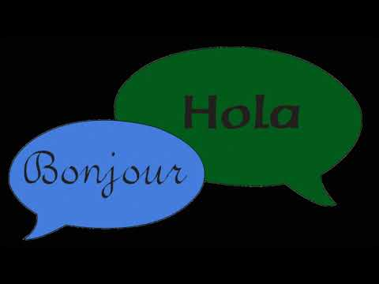

Slide 3
Questions?
Notes:
I hope you enjoyed viewing my presentation, I know that I certainly enjoyed creating it! I believe that my progress on this project has not only benefited the Woodrow Wilson House, but myself as well. The skills that I have gained in project management will undoubtedly be beneficial to both my professional and academic life. Education as well as accessibility has always been my passion, and I hope to see my project help those who need it. The Woodrow Wilson House scholars program has been an excellent opportunity which I hope others are able to utilize in the future. It has helped me, and I am sure that it will help others as well. I will now be opening the floor to questions if anyone has any inquiries about my process or the content of the work that I produced for this project.

