Slide 1
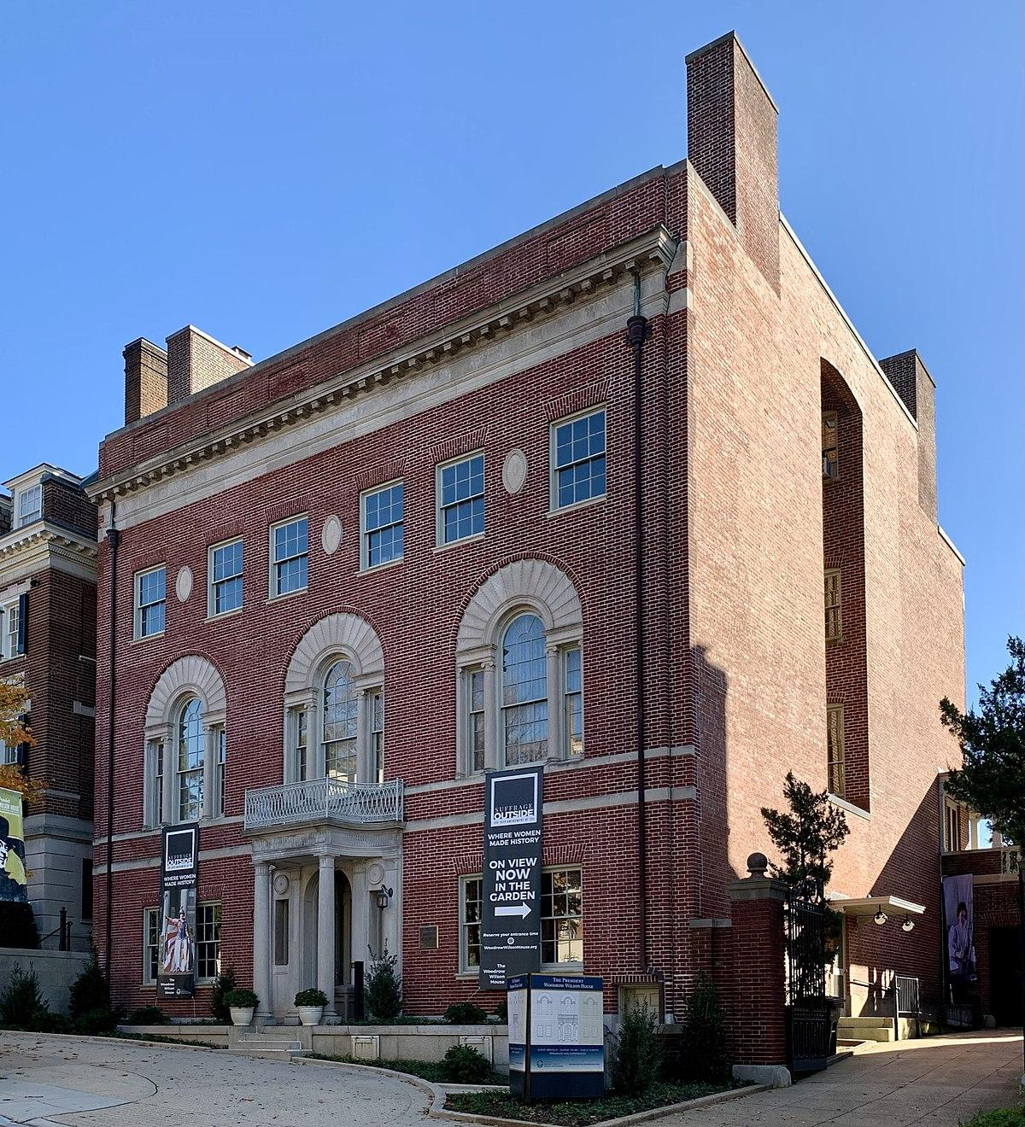
WWH Project Update
by Jess Nather

Slide 2
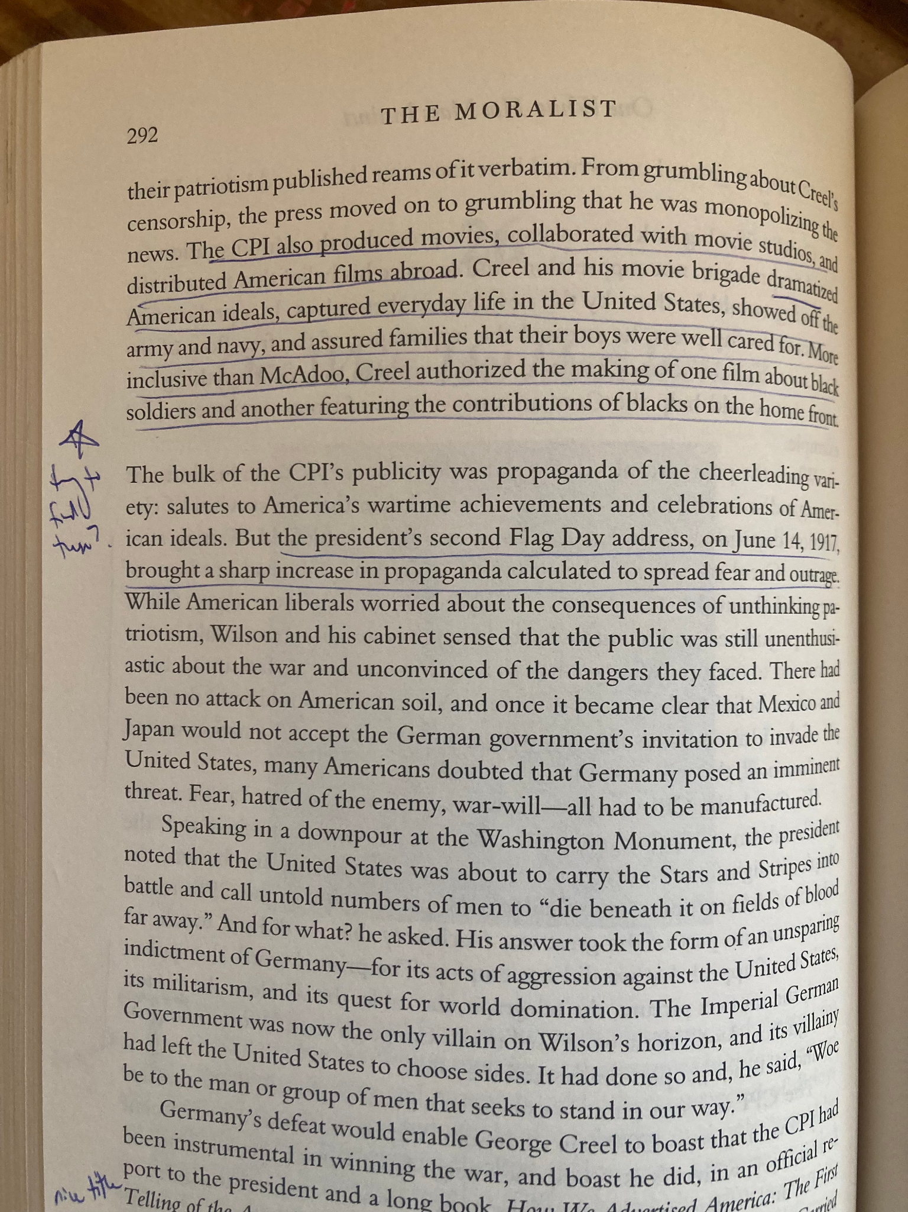
Step 1: Initial Research

Slide 3
Step 2: Choosing the Project
Political inconsistencies
Which situations were luck? True talent? Ill will? Or incompetence?
Possible TEDTalk format for final presentation

Slide 4
Step 3: Categories
Political Theory
African-American Rights
WWI
Interventionism

Slide 5
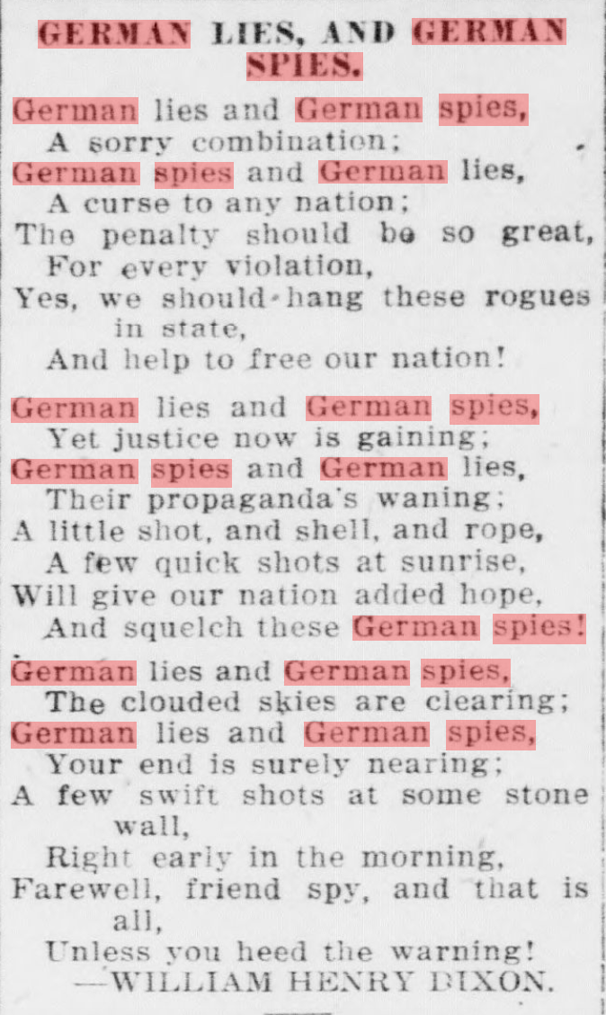
Successes and Dead Ends
Public speeches– found texts online
Rediscovery– contained mostly physical objects rather than documents
Chronicling America– super helpful (thanks, Ms. Stacey!). German espionage research

Slide 6
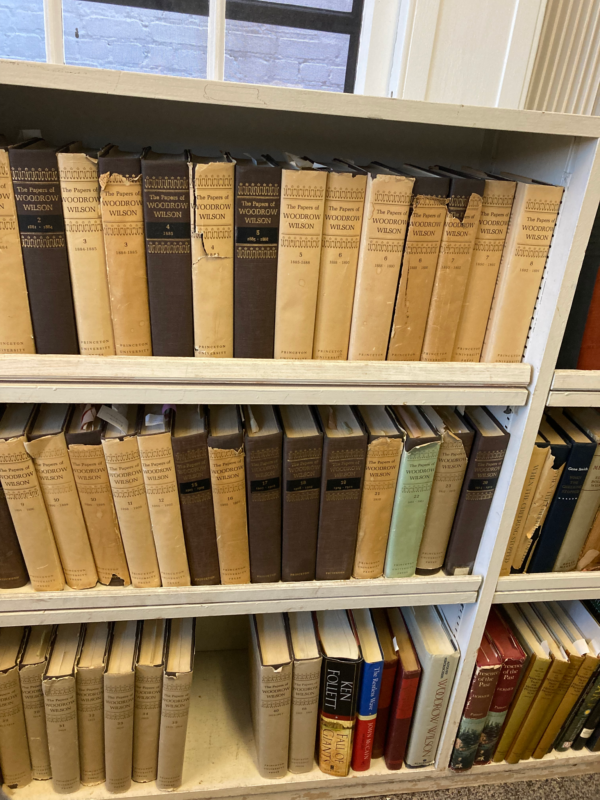
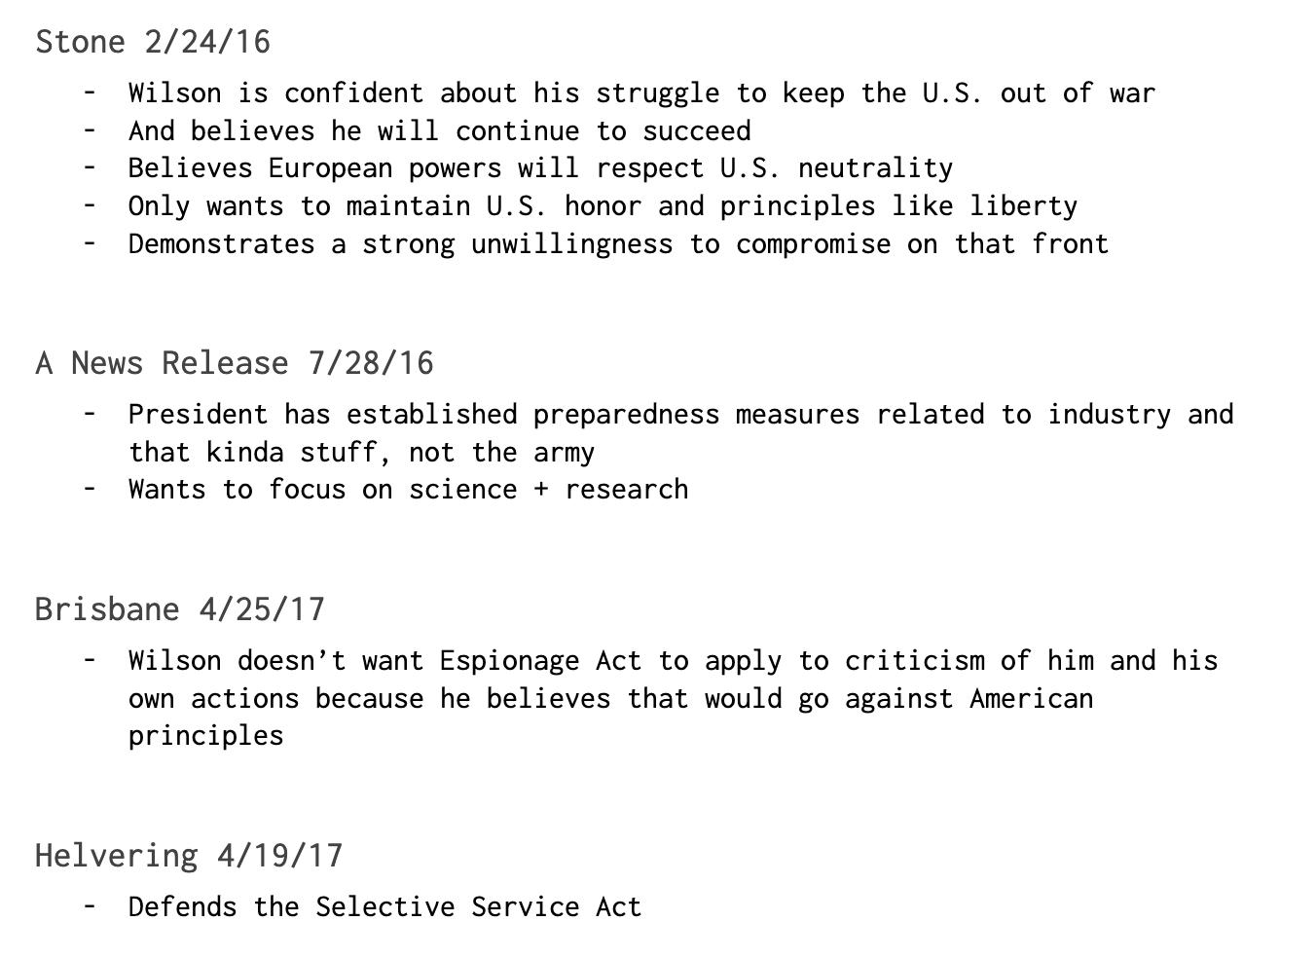
Arthur Link Papers

Slide 7
What’s Next?
Analyzing Link resources– war
Organize thoughts into specific observations + examples
Move on to next category: interventionism

Slide 8
Thanks for listening!

