Slide 1
Final Presentation
Owen Collander

Slide 2
TikToks

Slide 3
Silent Auction Advertisements

Slide 4
Social Media Schedule

Slide 5
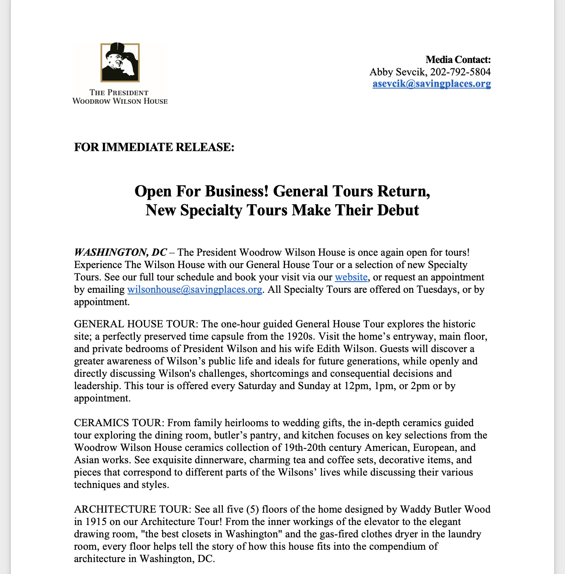
Press Release

Slide 6
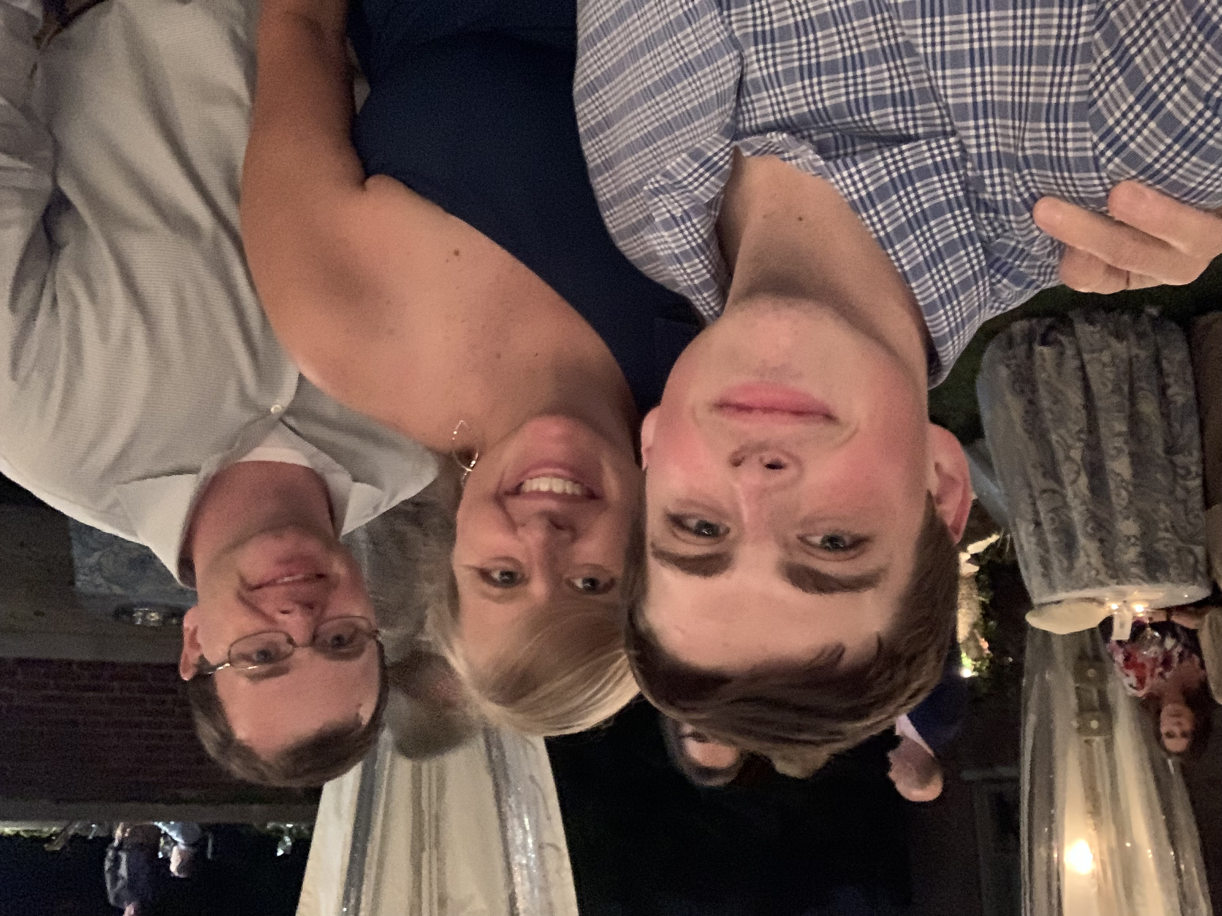
Daily Operations and Events

Slide 7
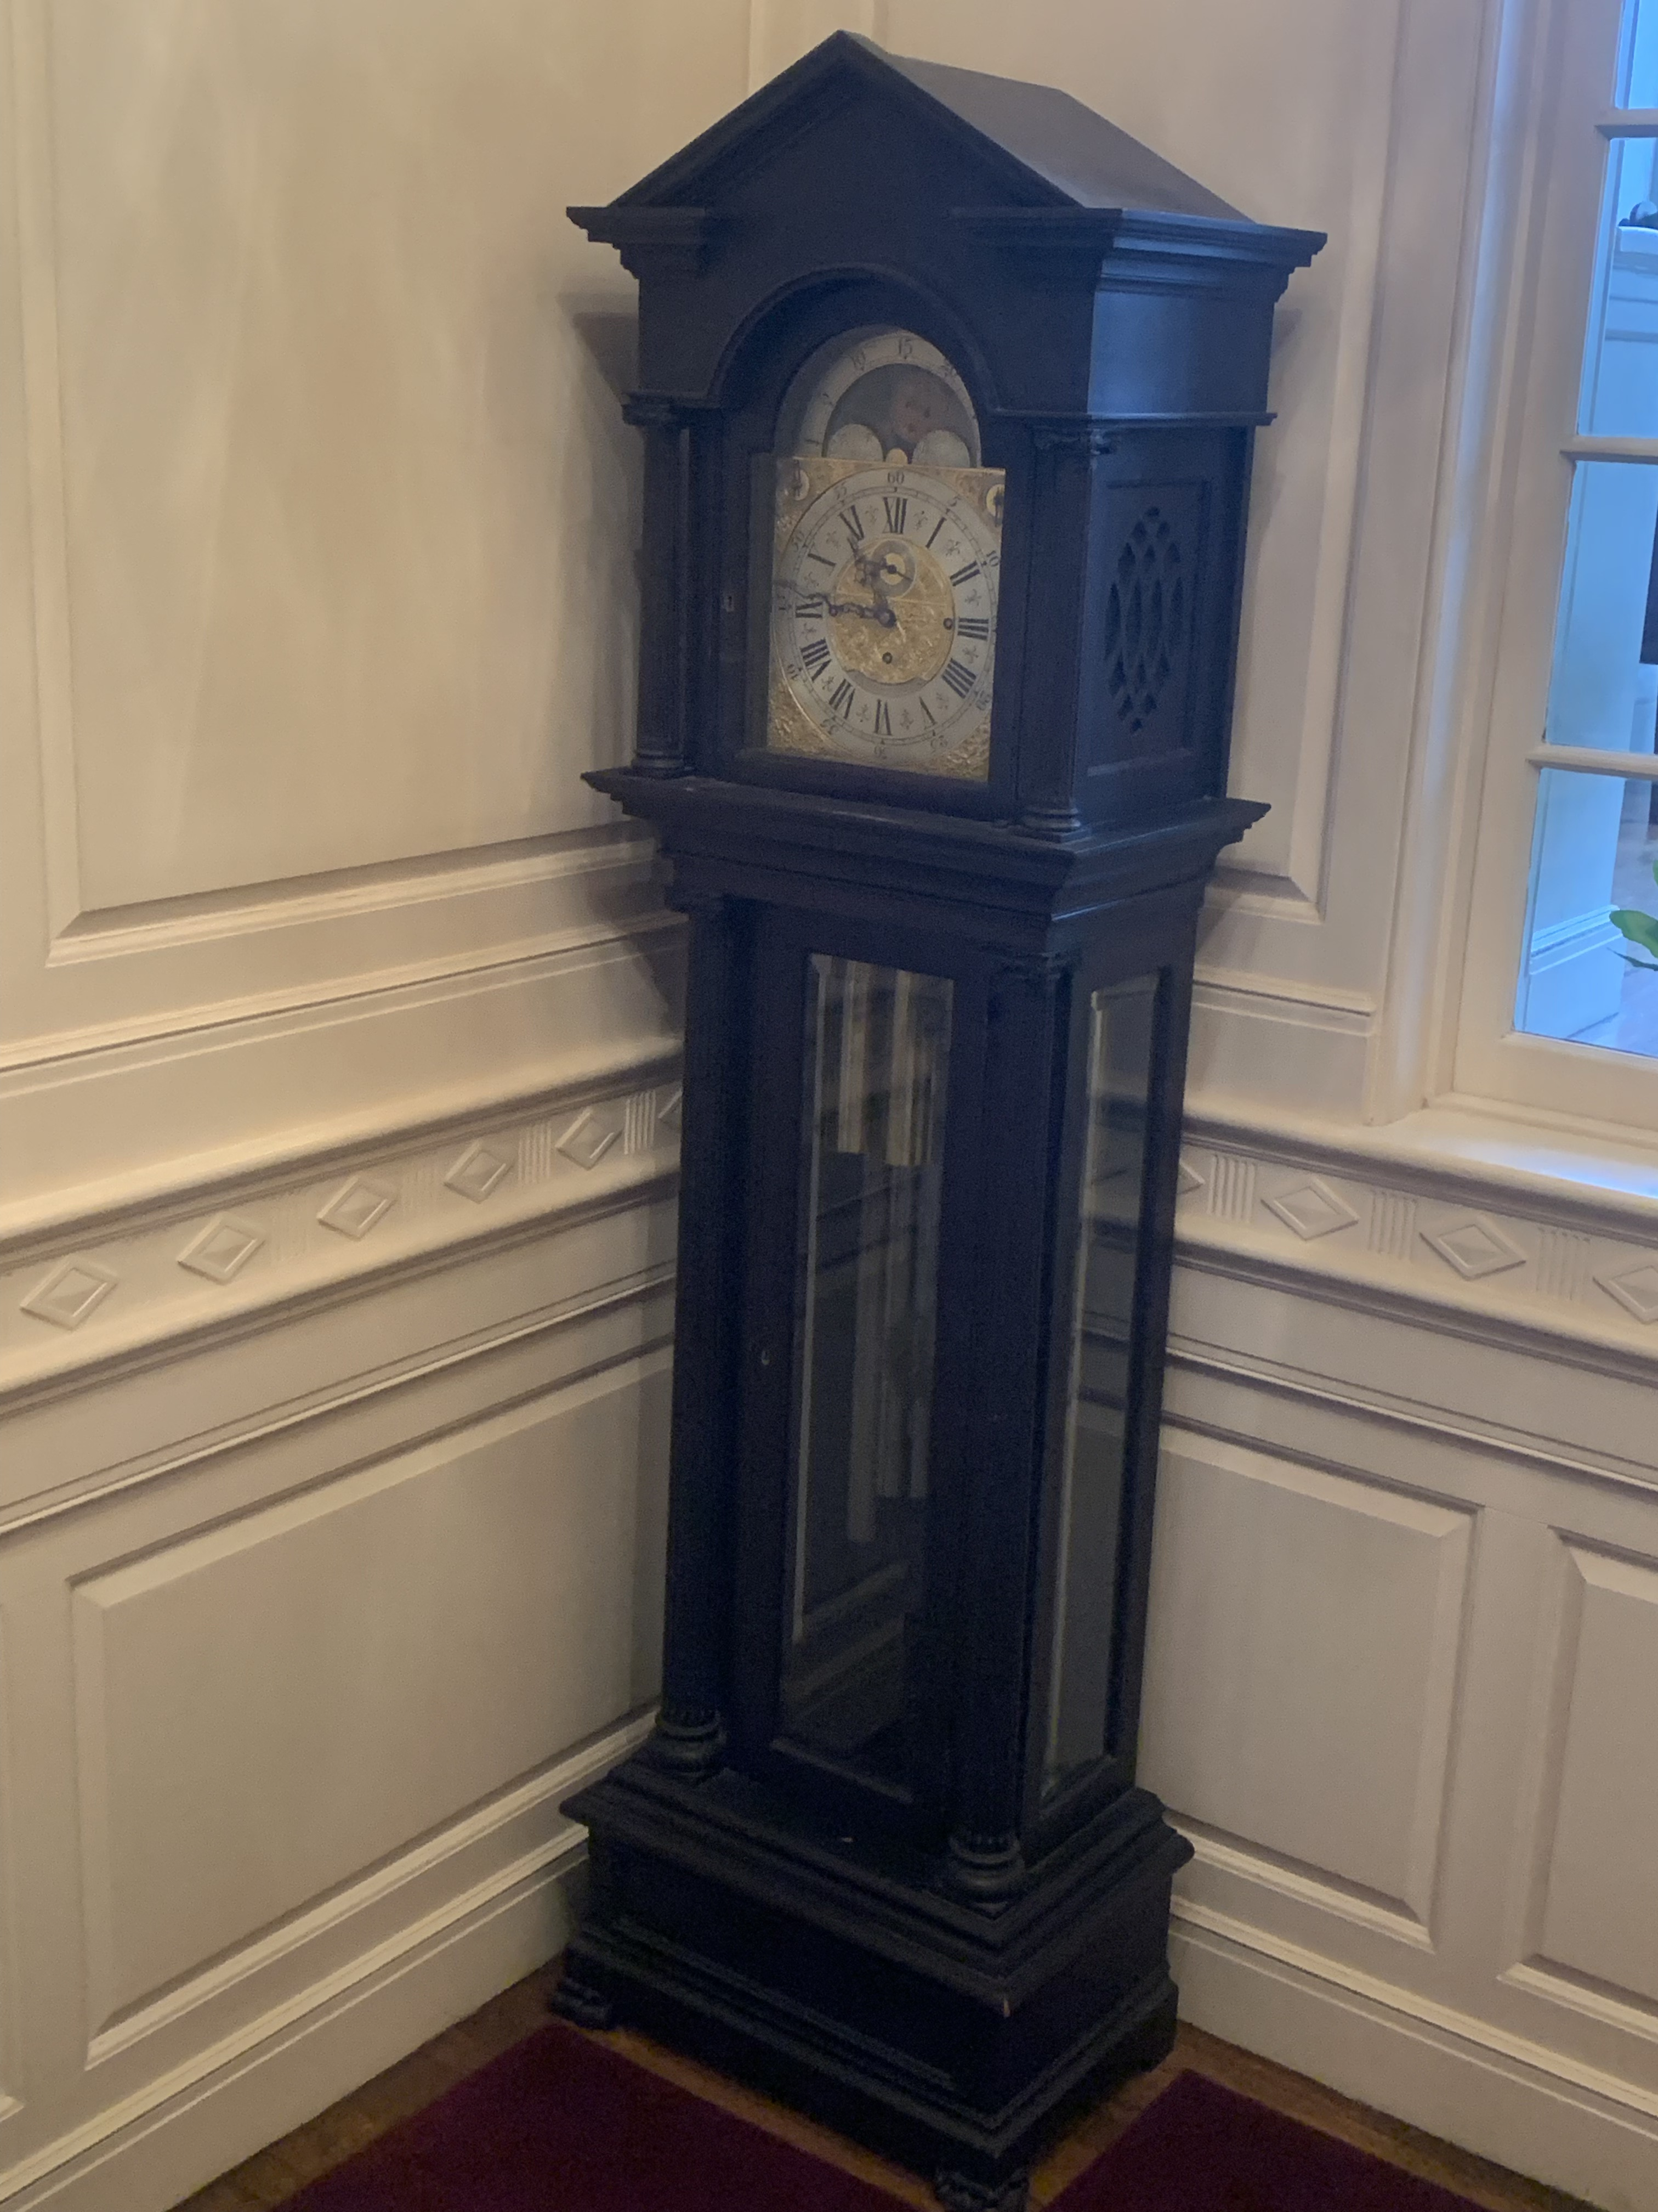

Slide 8
Collection Work

Slide 9
Thank you!

