Slide 1
Education at the
Woodrow Wilson House
Celia Roskin

Slide 2
Goal:
Creating resources that are engaging and accessible to teachers

Slide 3
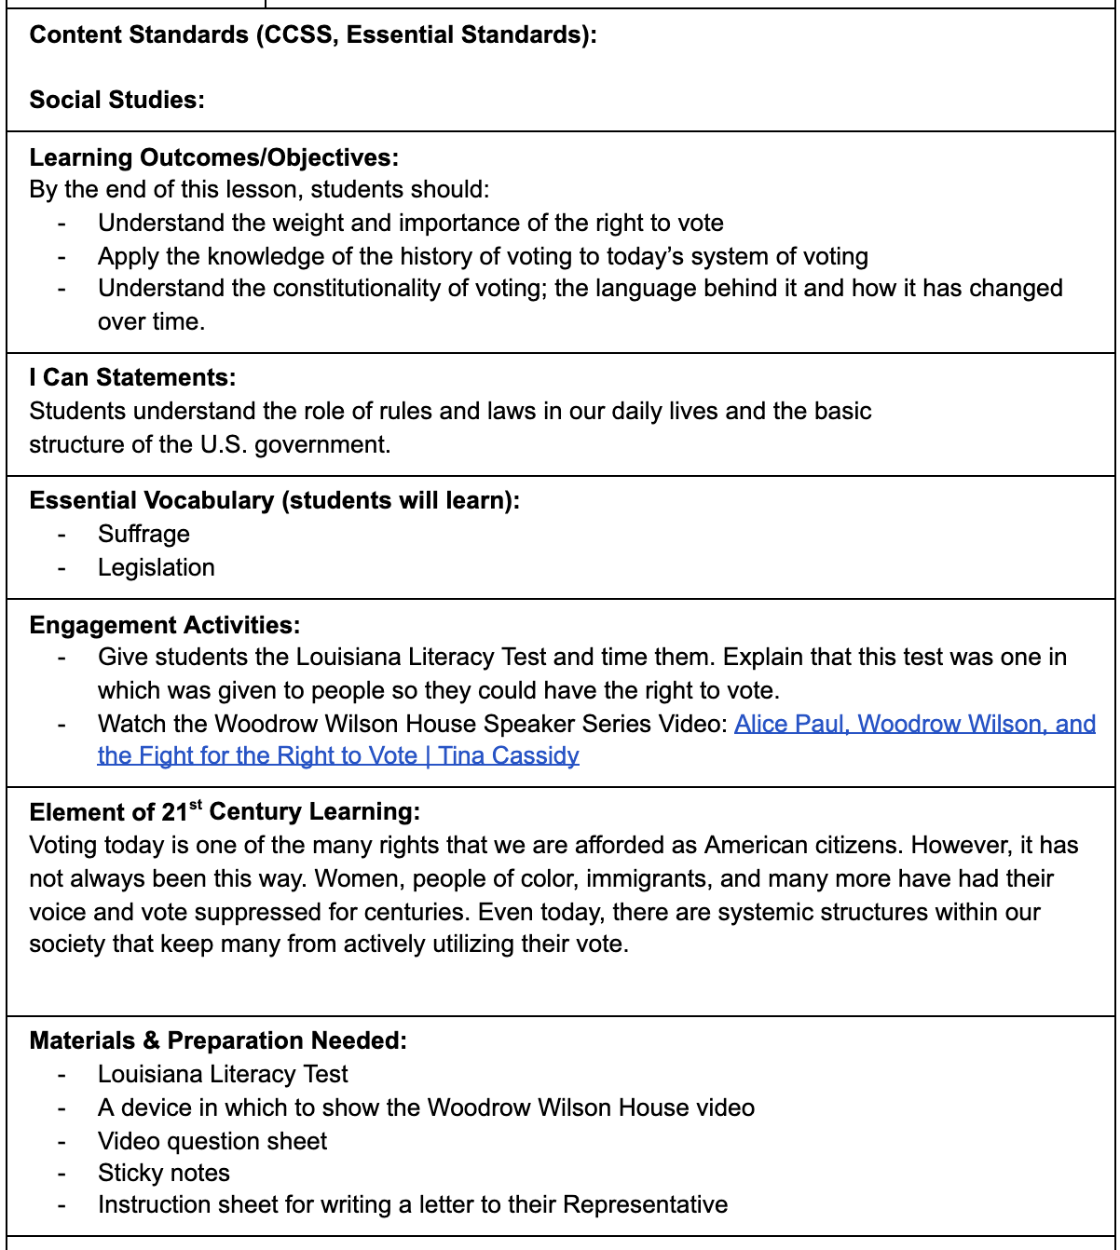
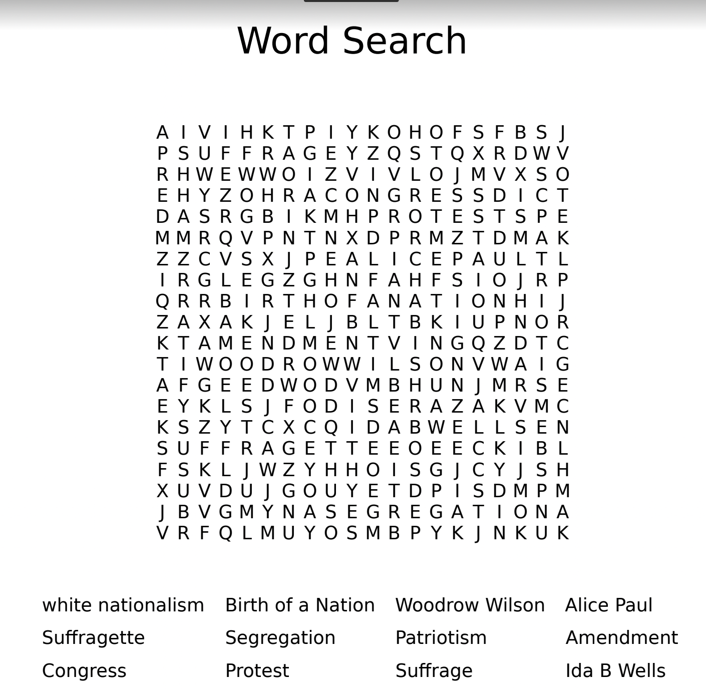
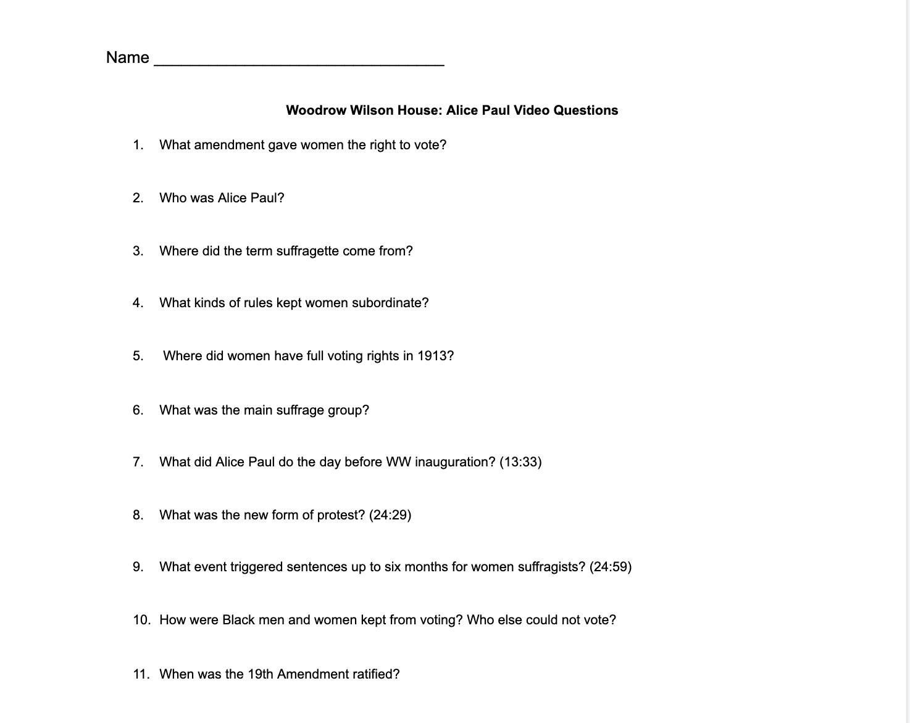
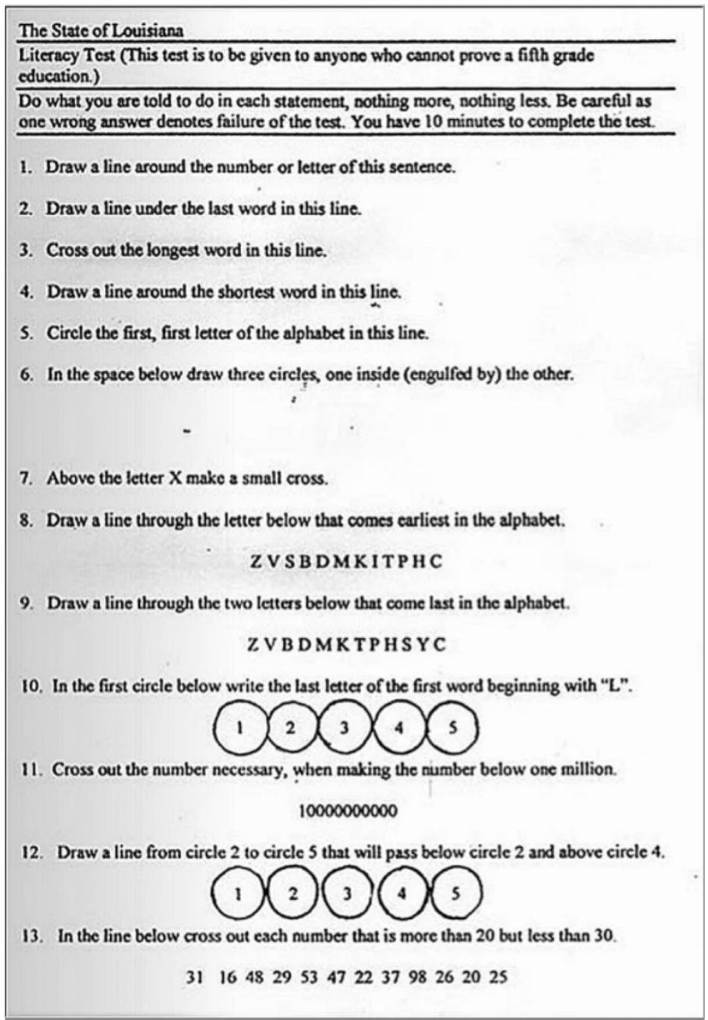
Creating Resources:

Slide 4
Creating a project
Group students based on their preference for the laws they care about the most. There should be 3-5 members in each group.
The assessment: Students will decide as a group whether to make a poster, powerpoint, skit, etc. on how they would propose this new law. Make sure it is convincing!
After the presentation, there will be an anonymous vote on whether the class would pass the new law. Must have a majority for it to pass!
3. In addition, students will write a group (or
individual) letter to their Congressman
explaining their ideas and project. The letter should be no more than 2 pages long. They will then print it out and send it to their Representative!

Slide 5
Takeaways

