Slide 1
My project during my second semesters at the Wilson house
Lakecia Richardson

Slide 2
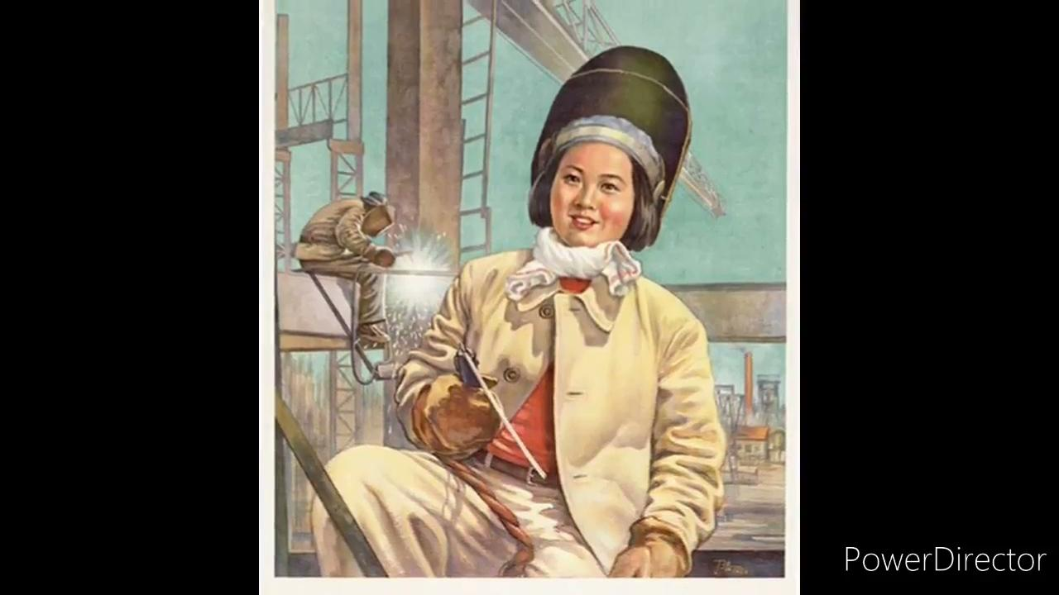
WW1 Documentary

