Slide 1
Notes:
Hello everyone my name is Taite Innes and I’m going to be walking you guys through what I worked on this Semester at the WWH. For a bit of an outline and what you guys will expect to see in the next couple minutes from me is a quick intro into who I am and why I am so excited to be a part of the Scholar program, then I’ll talk about the Lesson Plan Package I created and then finally reflect about my experience this semester.

Slide 3
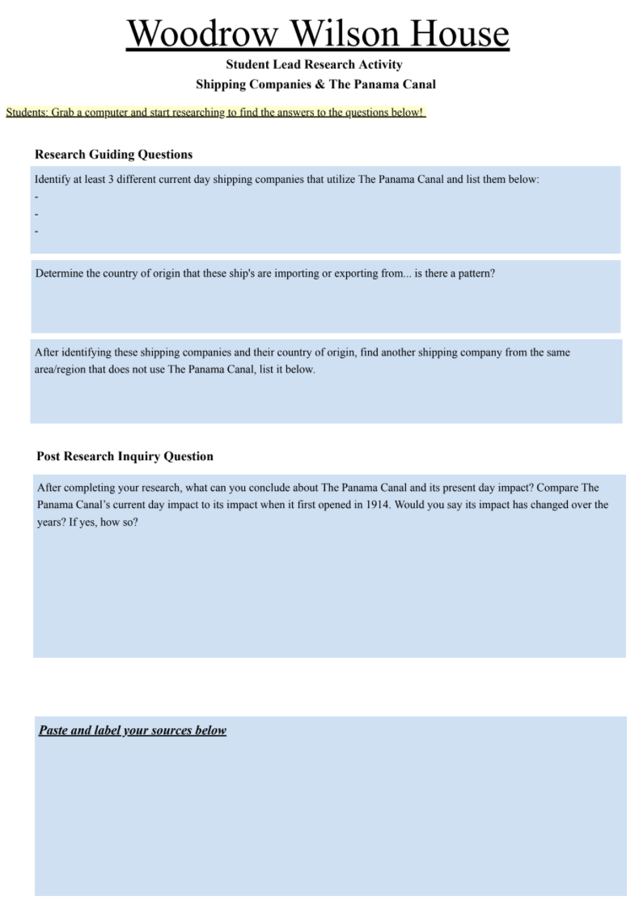
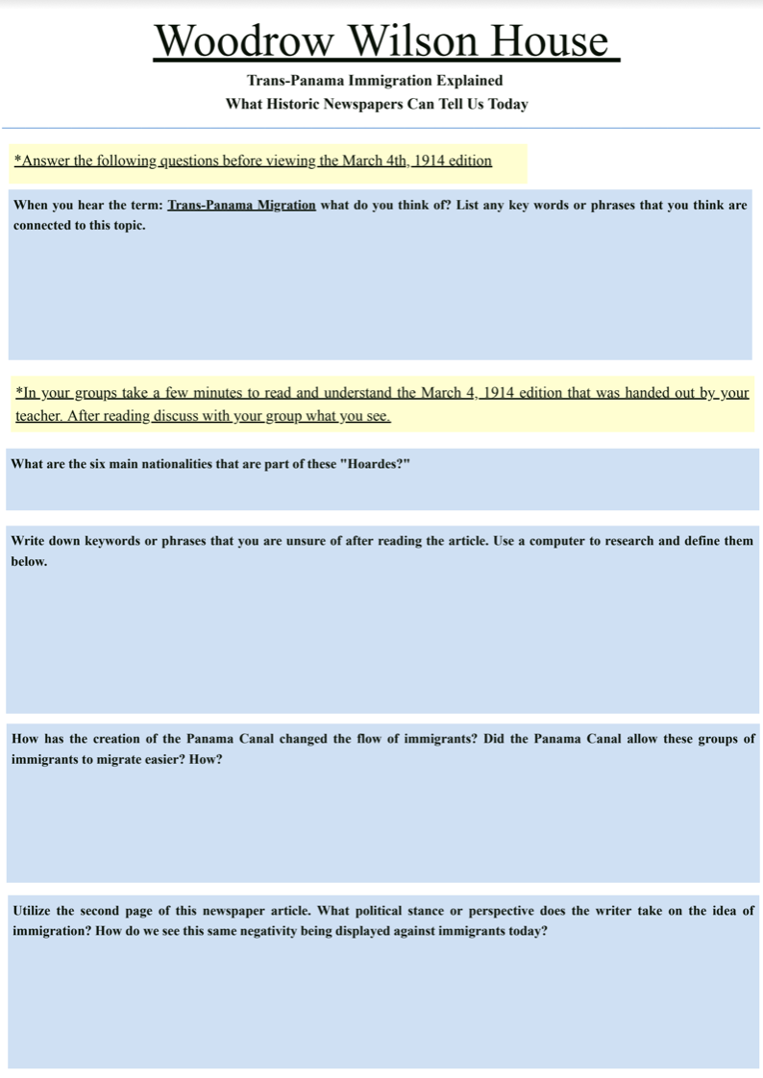
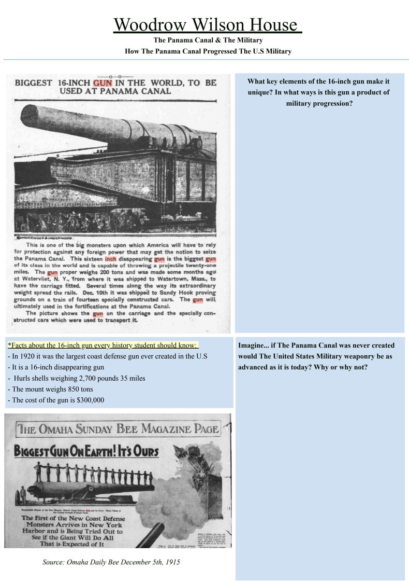
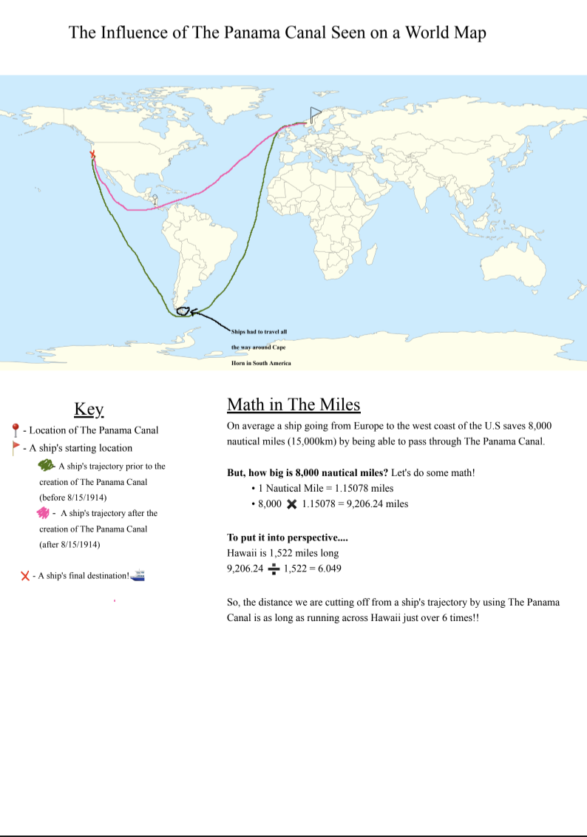
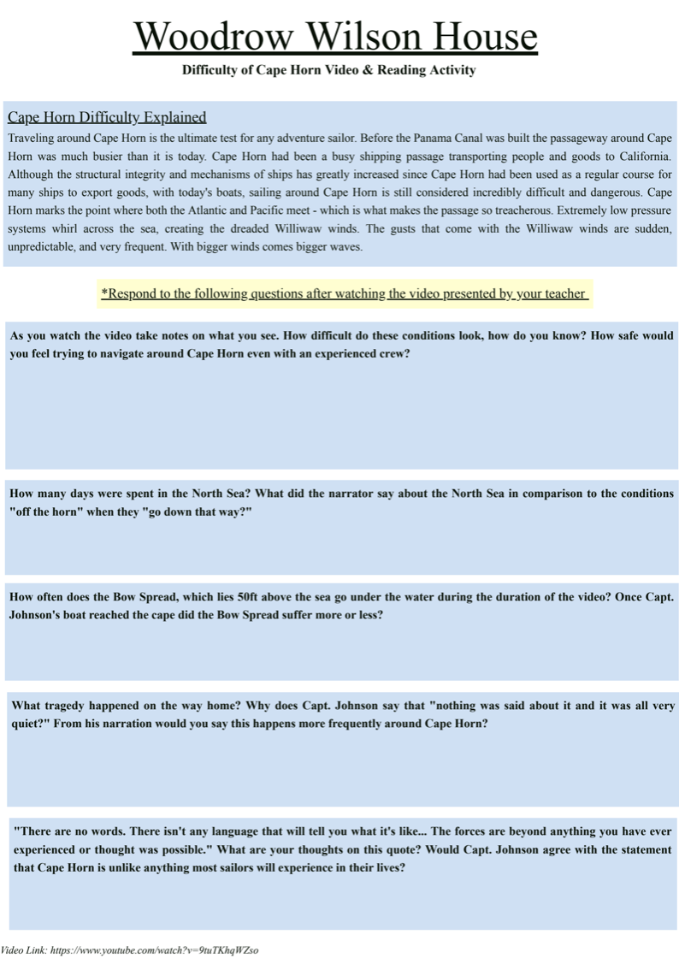
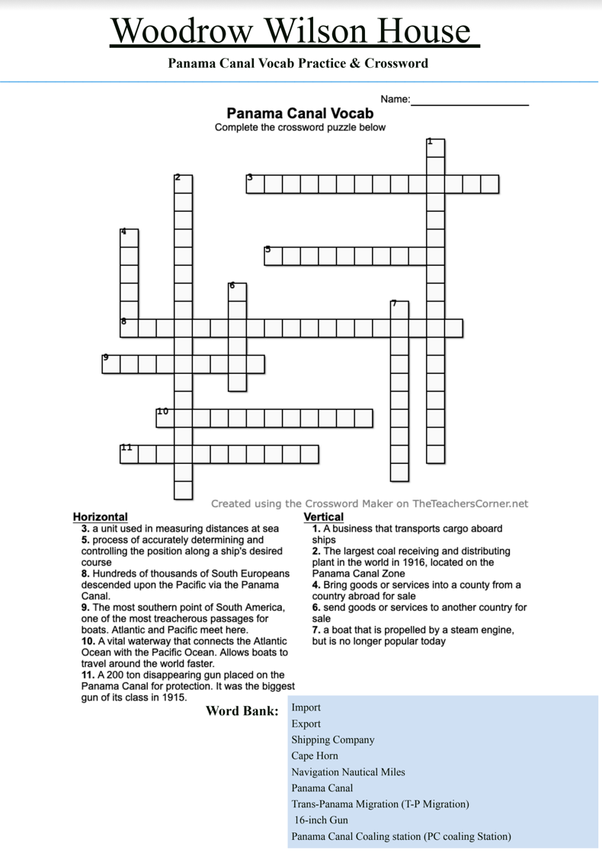
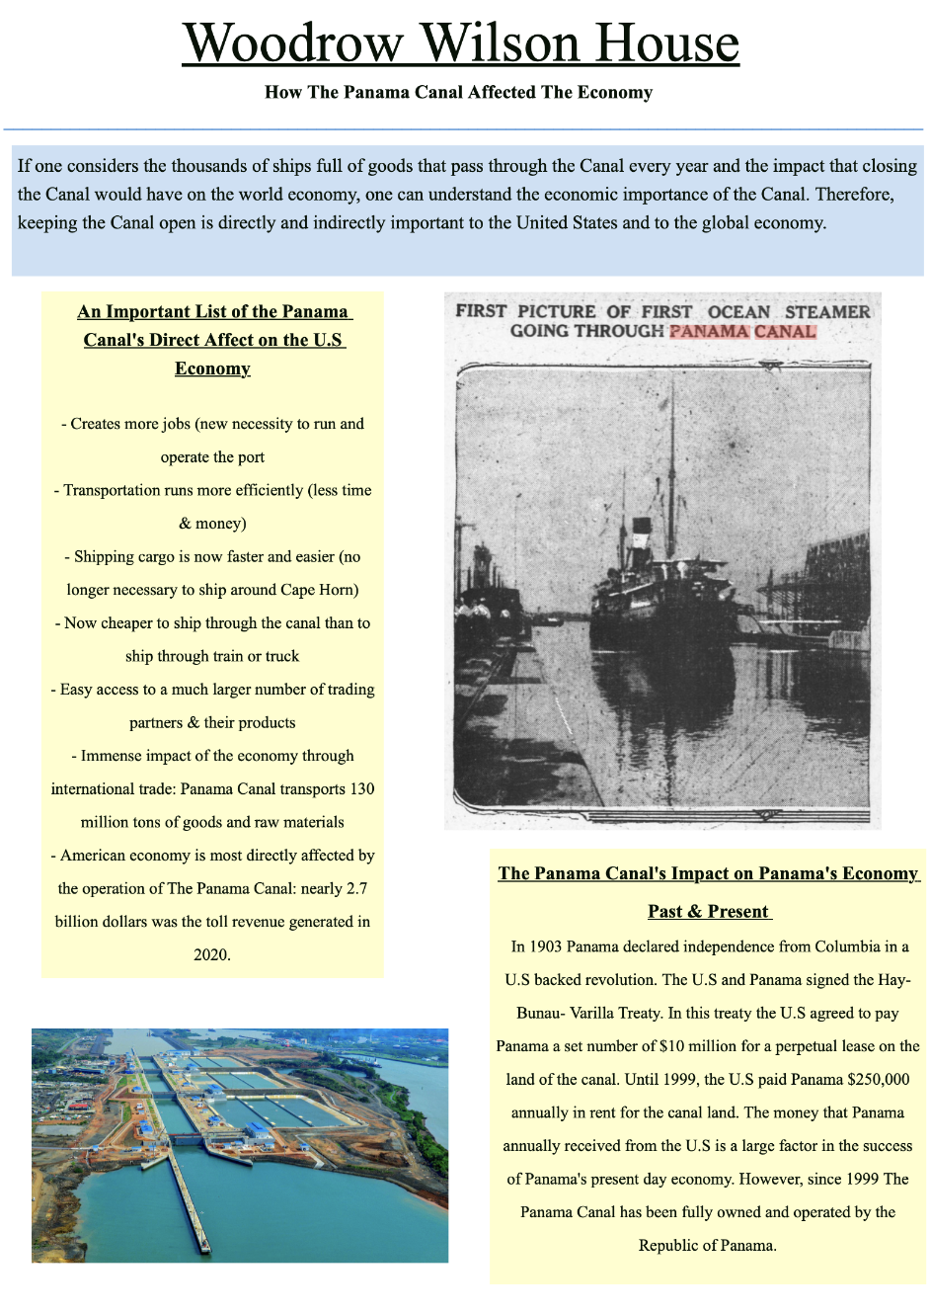
Notes:
This is a quick overview of the Lesson Plan Package I created. I decided to narrow in on Woodrow Wilson’s involvement of The Panama Canal and how this port really revolutionized global transportation and has played a key role in advancing our level of transportation seen today. I made a total of 7 different activities. In creating a lesson plan for High school students you want to take into account that there is so much information to convey, but also that there is a variety of learning styles among students.
Wordplay with crossword (connect into subject matter through words, the reader type of students, those who love languages)
Video for those who are visual learners
Some might connect to the subject matter through a math exercise (more math oriented students)
I provided a number of ways to connect to the material which keeps it interesting for all types of students.

Slide 4
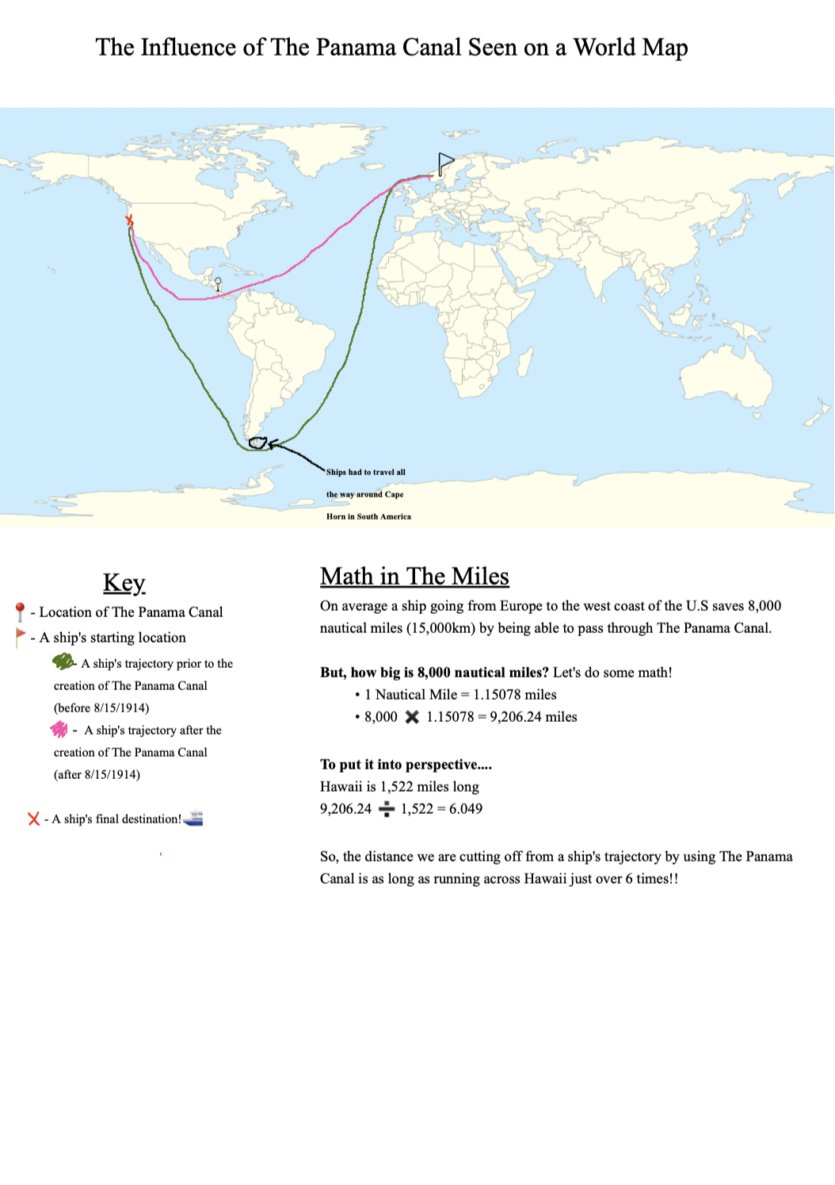
Panama Canal Lesson Plan Activity #1
Old shipping route vs. new shipping route
Math activity of nautical mileage comparison
Connects students who are more math oriented
Connects students who are more visually oriented
Notes:
This activity is one that I created for a more math and visual oriented student. I drew on a map to show the old and new shipping routes from before the Canal was created to how the route changed when it began running in 1914. Utilized math here to calculate the nautical mileage to stress how much time and energy the new Panama Canal route saves.

Slide 5
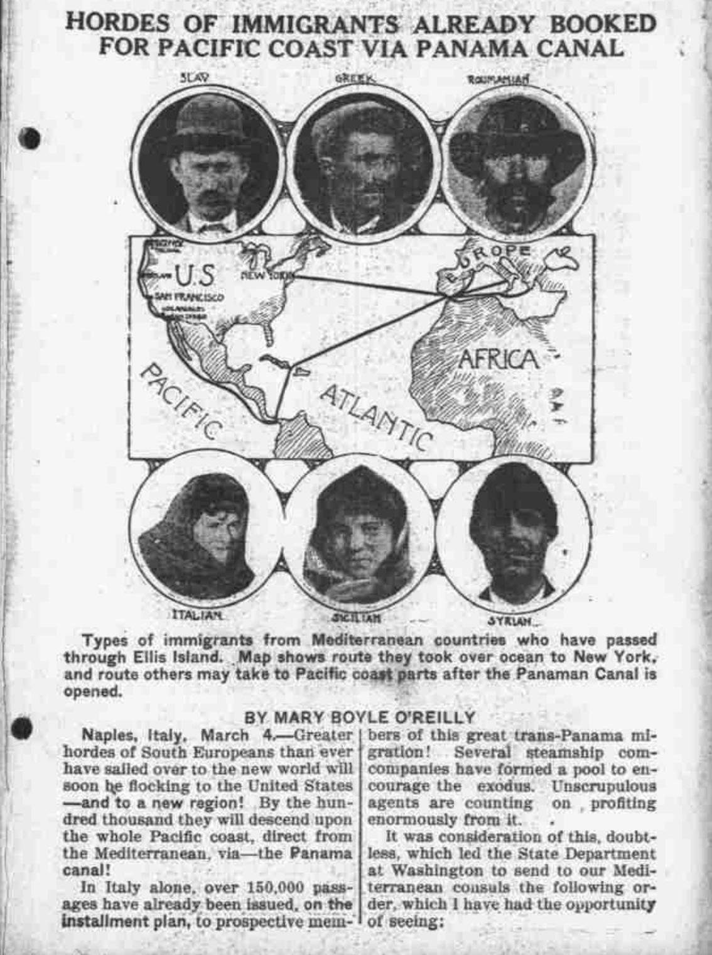
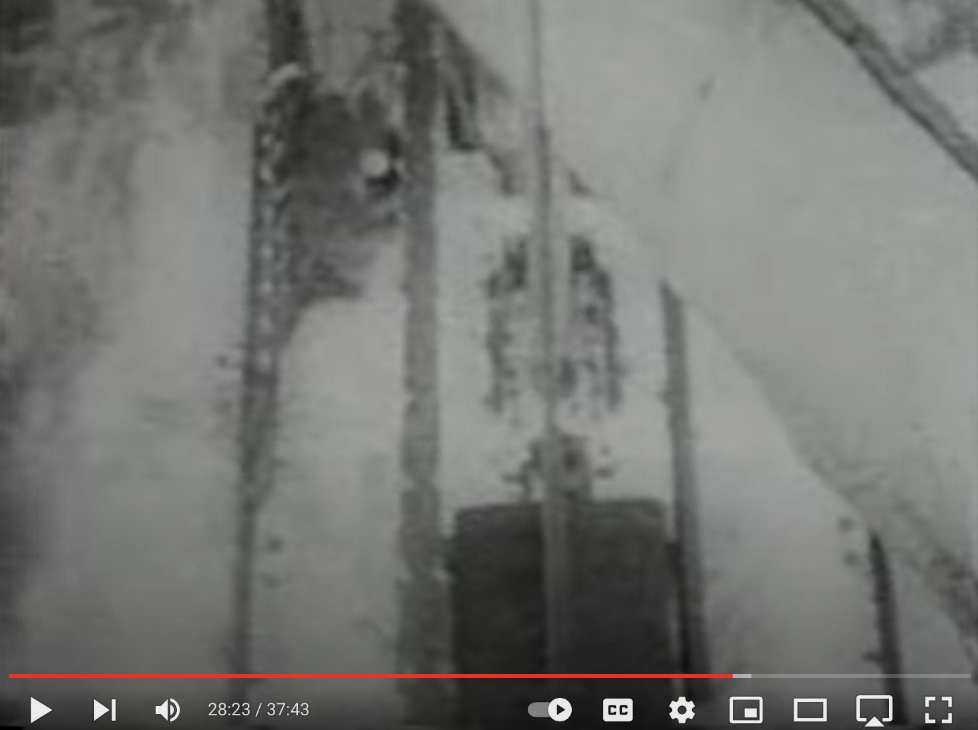
Notes:
This next activity I utilized a video for the more visually oriented students. This video was about a real life ship’s journey on the old shipping route before the Canal opened and how treacherous the journey really was. You can see if the above picture a bird’s eye view of the ship’s deck and how the water is engulfing the ship. This is what ships had to experience going around Cape Horn (tip of south america, to get around to california in the old route) it was incredibly dangerous and this was really where the pressure came from to create this canal

Slide 6
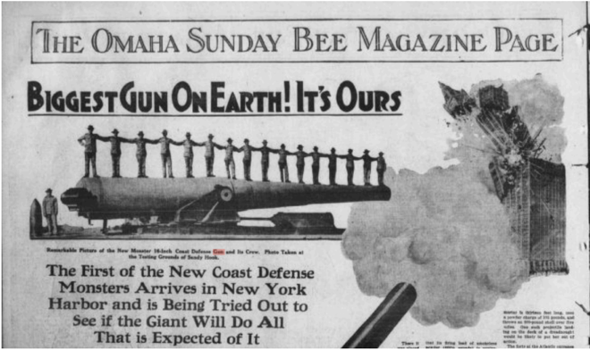
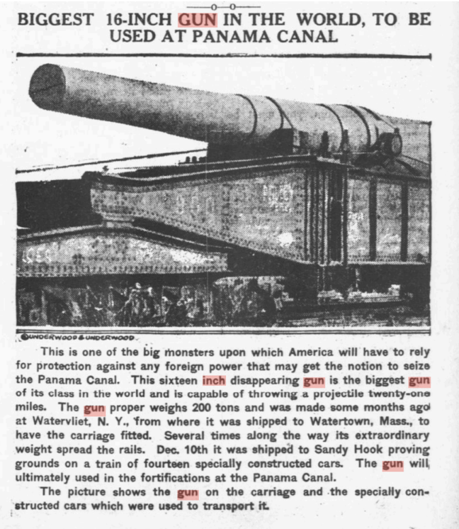
Notes:
This activity I utilized the primary sources in the Library of Congress again and a vocab crossword puzzle for the students who are word oriented and love language. This activity narrowed in on the 16-inch gun that was attached to the Canal and how this really pushed the envelope for future military weaponry. This was my favorite activity to create because the subject was very interesting to me and I had no idea that this gun was actually put into place. Shows that this new weaponry with a barrel of around 66ft and a cost of 3 billion dollars today is just specifically created to protect this new transportation asset, so you can imagine how incredibly important this Canal really was and still is.

Slide 7
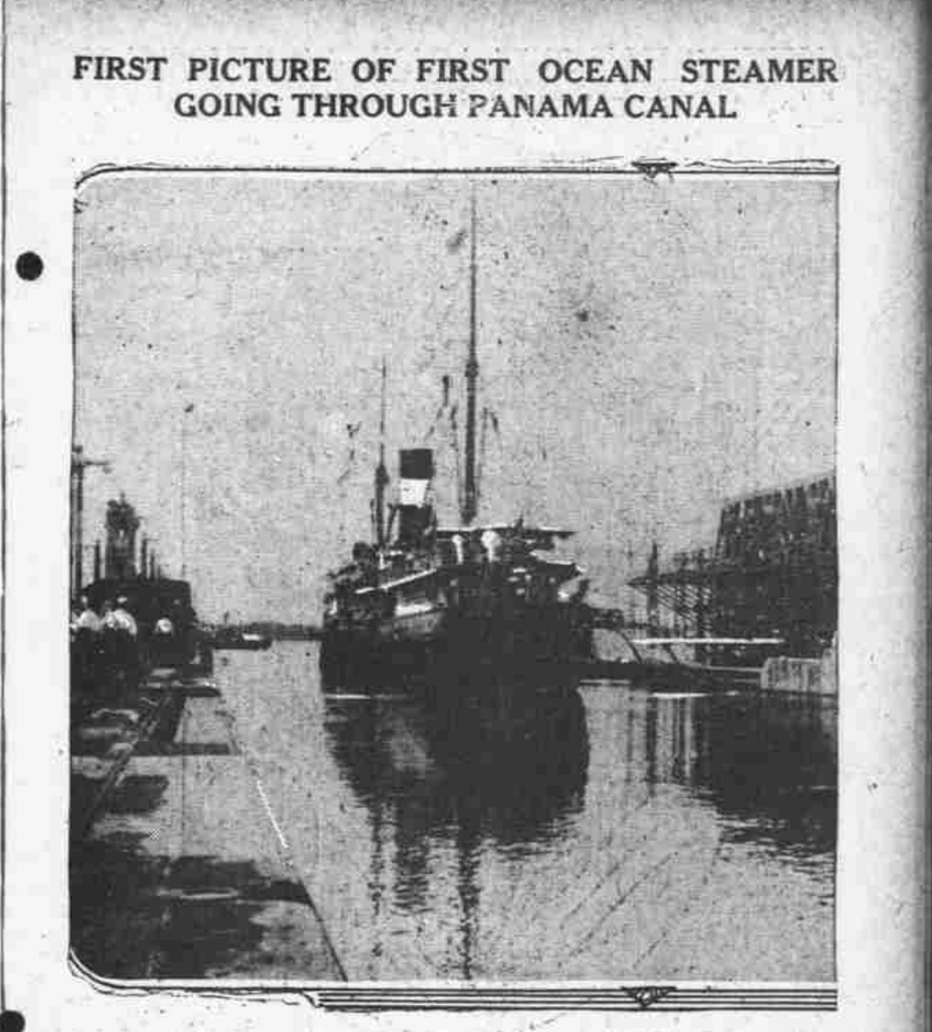
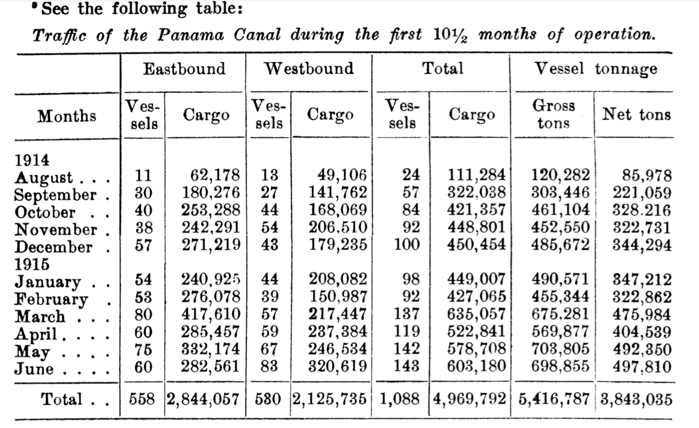
Notes:
My final activity was one I created about the Canals affect on the economy and presented it so it was attuned to the more visual and language oriented students. You can see this is a primary source chart of the traffic in the first 10.5 months of the canal being opened. I used this to show how these numbers reflect the economy and the amount of cargo that was being transported. You can see in the chart the total in the first 10.5 months of # of vessels going through is 558 and compare that to the 2020 # of over 13,000 it’s clear the canal is still having a lasting effect on the world economy. This is what really makes the Wilson administration so interesting is that it has lasting effects on things that have only expanded since his death and we see that just by the increasing # of ships going through this canal.

Slide 8
My biggest challenge was narrowing in on a topic
Support I received
Resources given
Looking forward to creating more projects for the WWH
Notes:
That presentation summed up the entirety of my work this semester. The biggest challenge for me was simply narrowing in on what I really wanted to spend my time working on, because there were just so many possibilities.I was drawn to making a lesson plan about the Panama Canal because it is an example of what really makes the Wilson administration so interesting is that it has lasting effects on things that have only expanded since his death and we see that just by the increasing # of ships going through the canal.
I was really surprised at how supportive the people here are towards the Scholars, especially Stacey taking time to meet me at least once a week, and the resources and advice that she gave me this semester. I’m really looking forward to the upcoming projects I will be working on.

